Slide 1
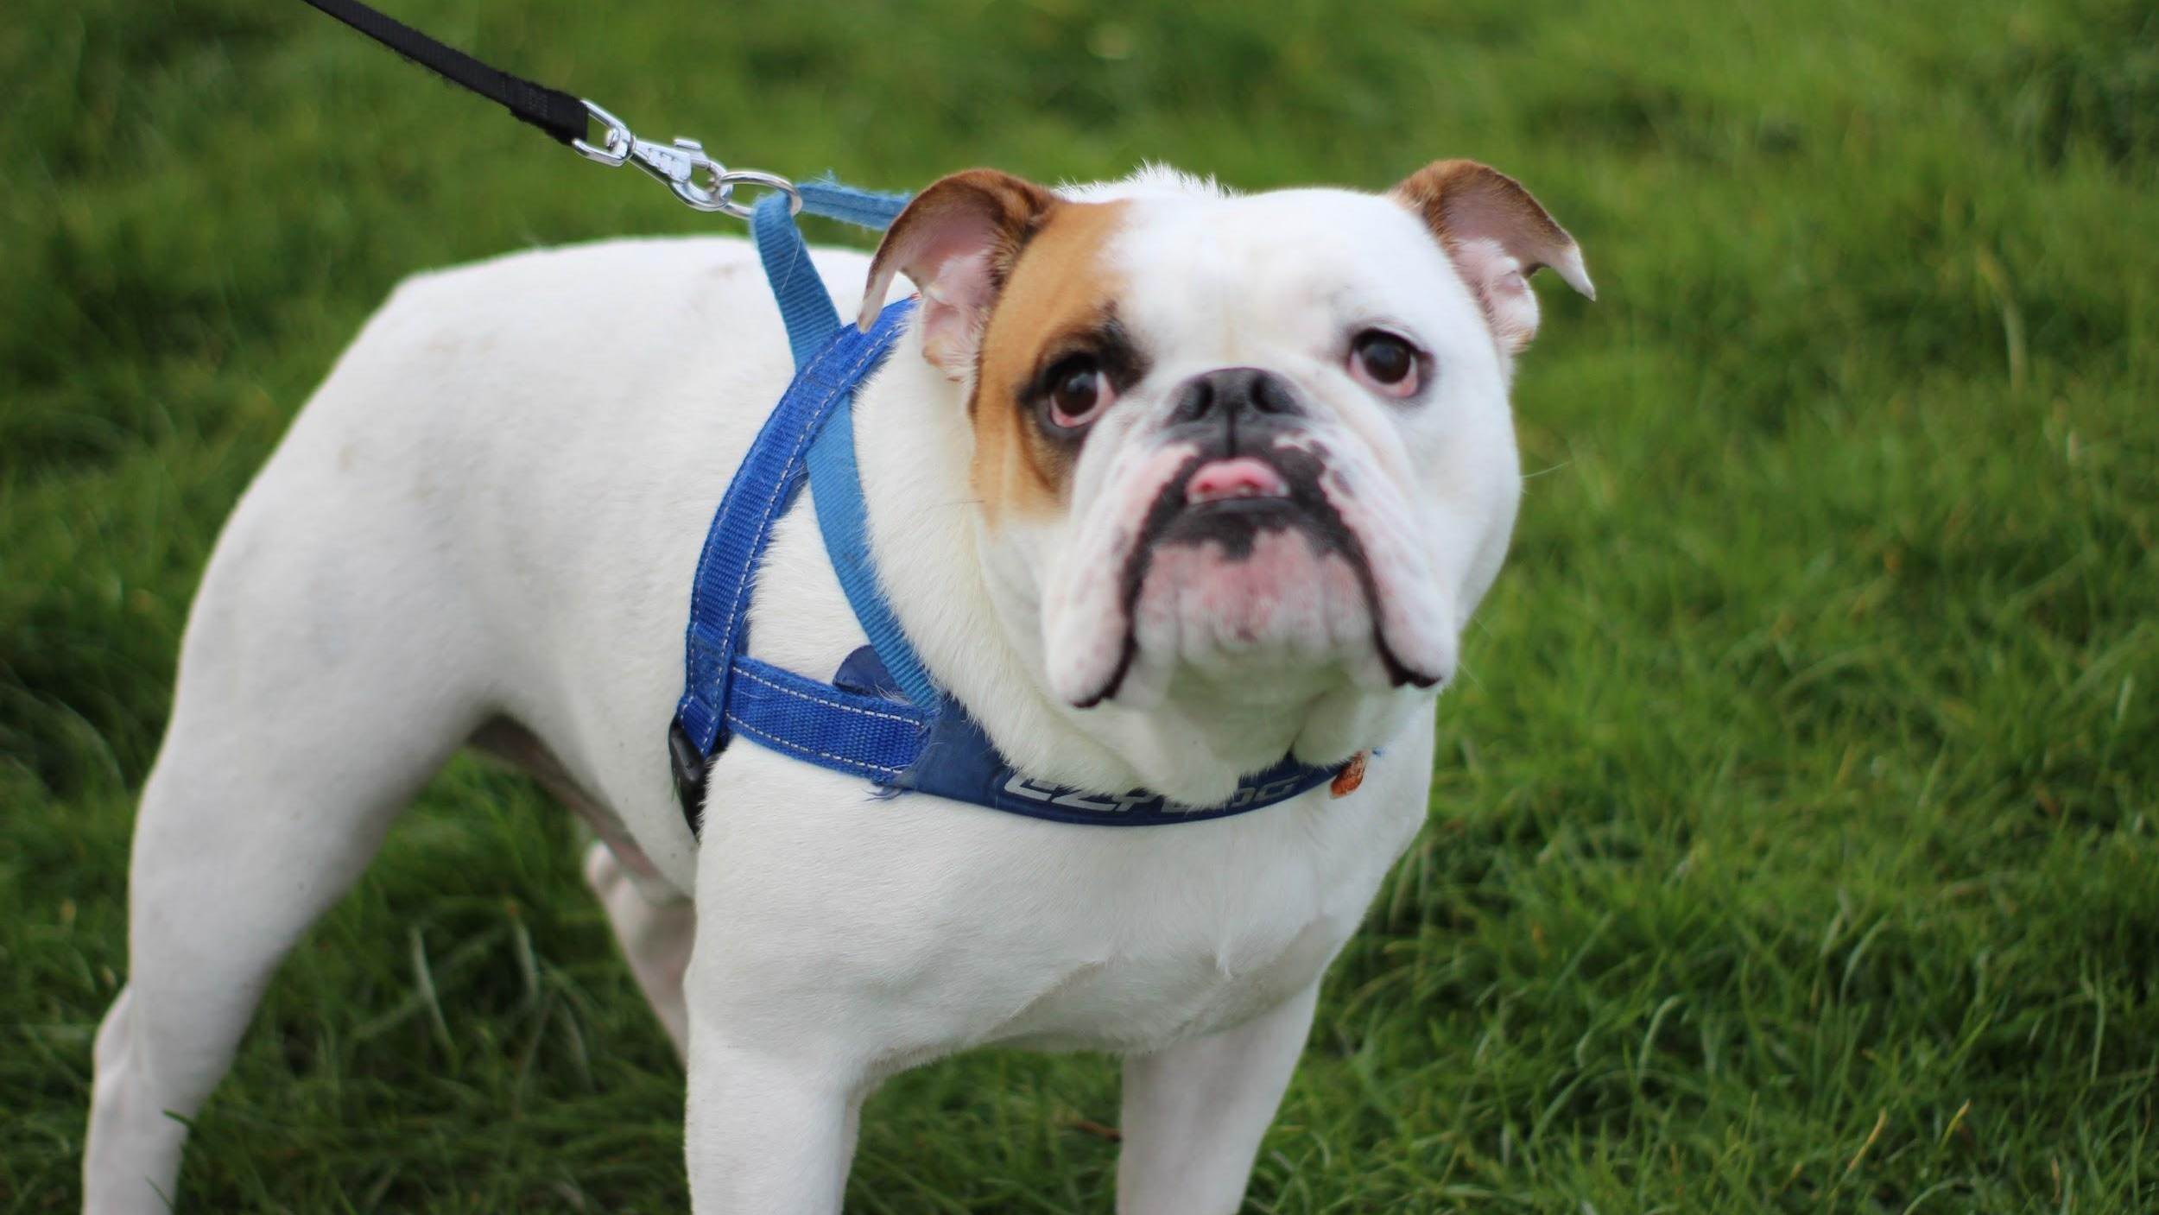
ORGANISM CHARACTERISTICS
We will describe the characteristics of organisms.
Notes:
Insert cover image and use transparency settings to fade image.

Slide 2
Do not delete this slide.
This slide is designed so that you can copy the prompt box you need and insert it into your slides.
This slide is hidden and will not be included when presenting your lesson.
TRACK WITH ME
VOCABULARY
1 -
HINT
Students, remember….
CHECK FOR UNDERSTANDING
READ WITH ME
TEACHER CUE
MAKE THE CONNECTION
Students, you already know….
EXTENSION
GESTURE WITH ME

Slide 3
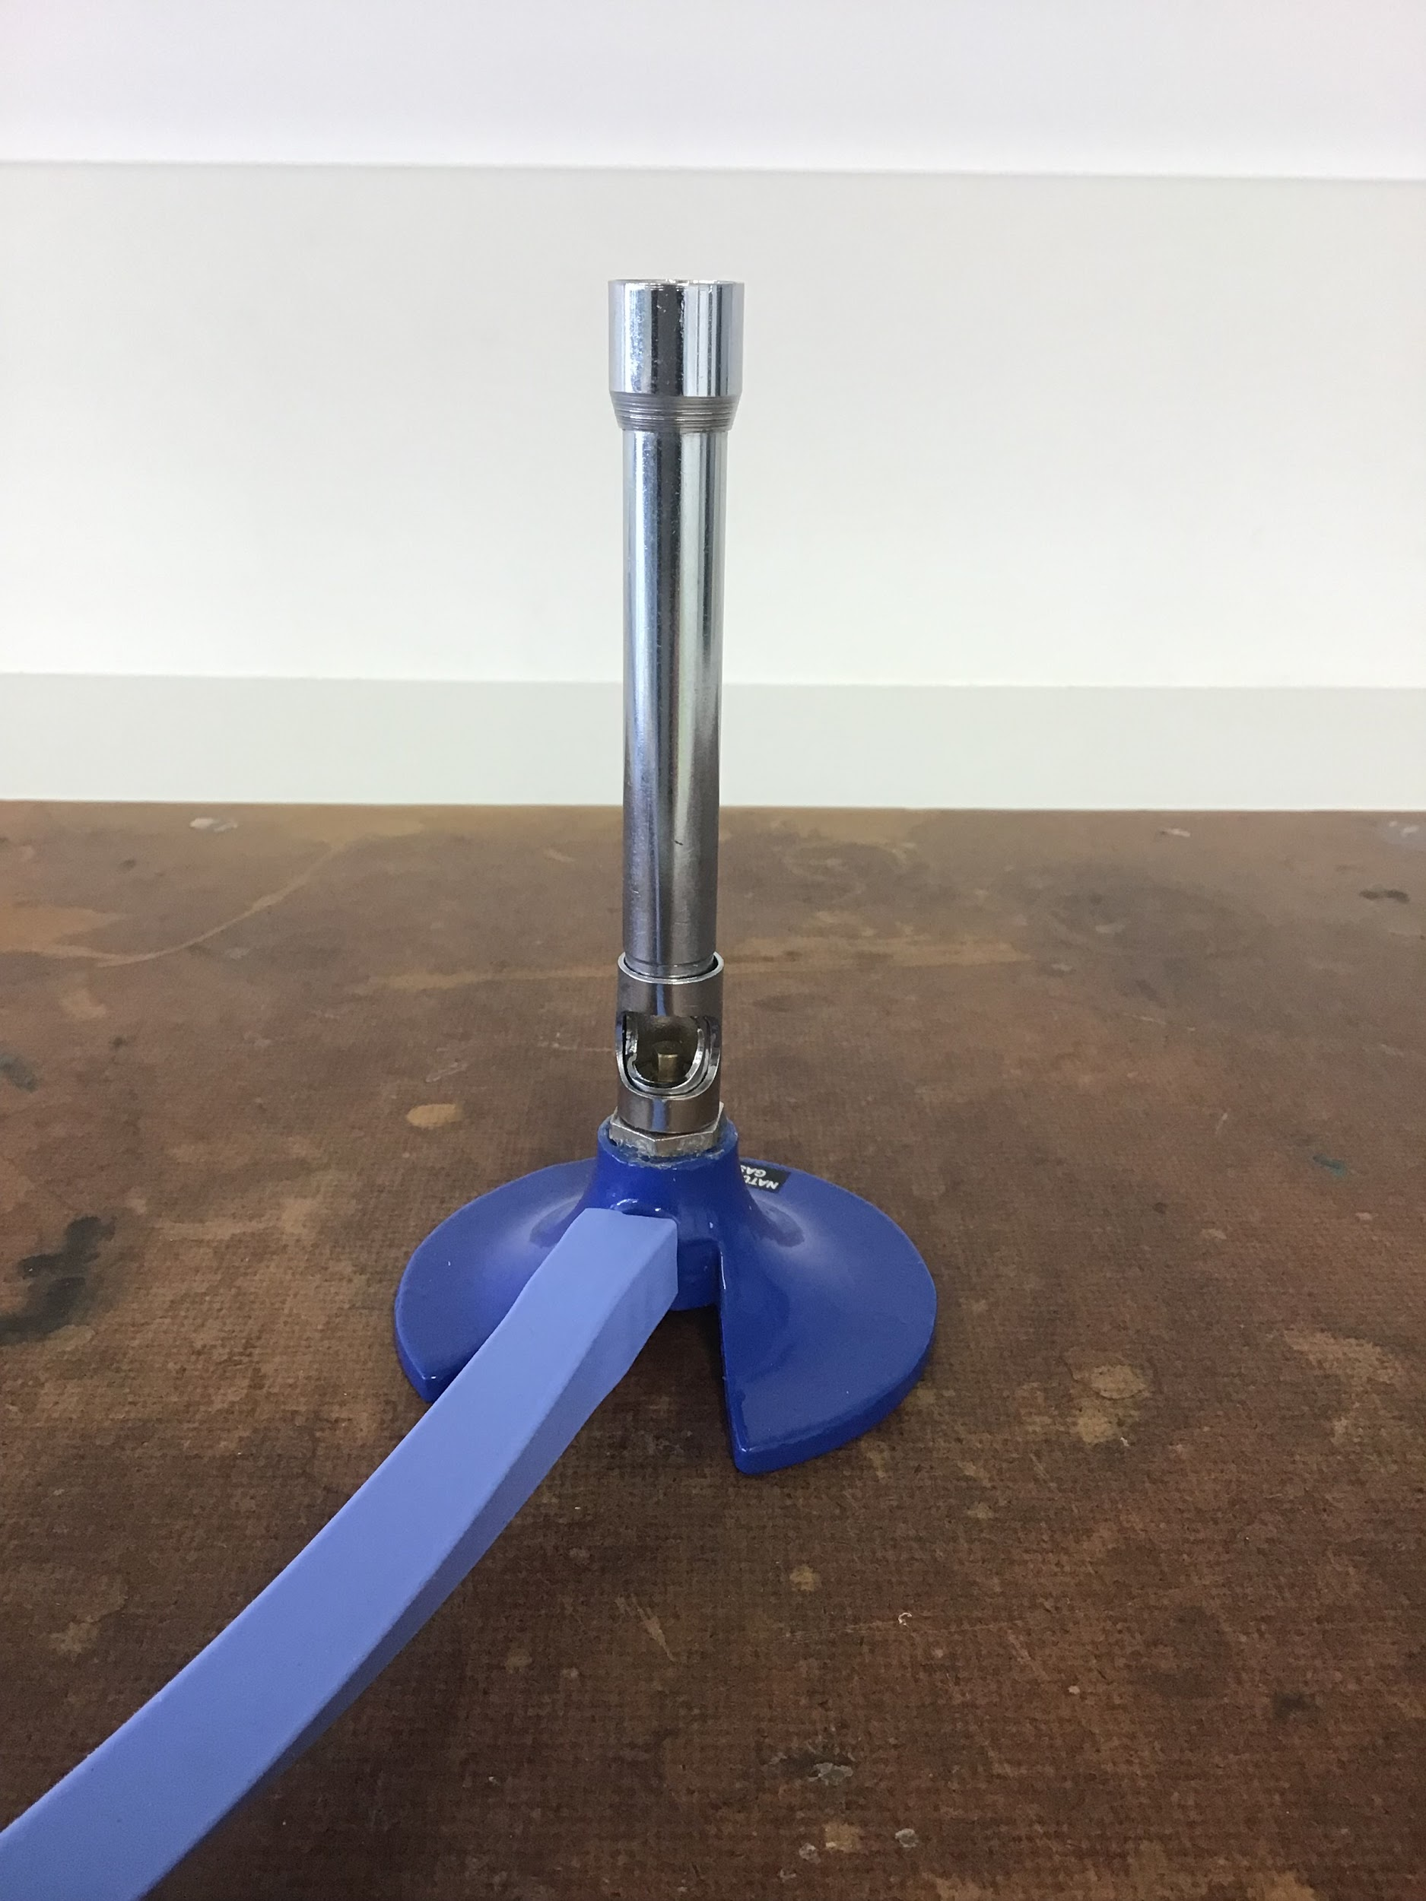
We will demonstrate lighting and extinguishing a Bunsen burner safely.
Label the parts of the Bunsen burner.
5
1
4
A | Airhole
B | Base
C | Collar
D | Barrel
E | Gas hose
3
2

Slide 4
Repeat the opposite word/phrase.
LABORATORY
ROOM FOR SCIENCE

Slide 5
Repeat the opposite word/phrase.
OBSERVATION
WE USE OUR SENSES

Slide 6
Repeat the opposite word/phrase.
INFERENCE
WHAT WE THINK IS HAPPENING

Slide 7
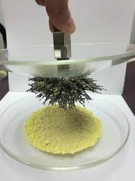
Identify the correct separation technique:
Iron filings from sand:
Handpicking
Decantation
Magnetic separation

Slide 8
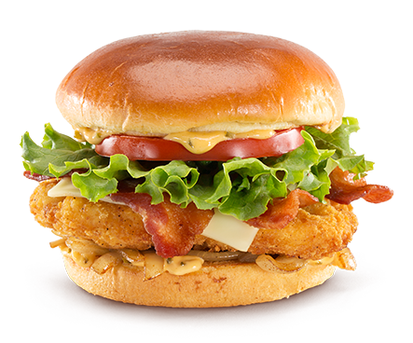
Identify the correct separation technique to separate the onion in this hamburger
Handpicking
Decantation
Magnetic separation
Filtration
Evaporation

Slide 9

When we light a Bunsen burner, what do we do first?
Turn on the gas.
or
Light the match.

Slide 10
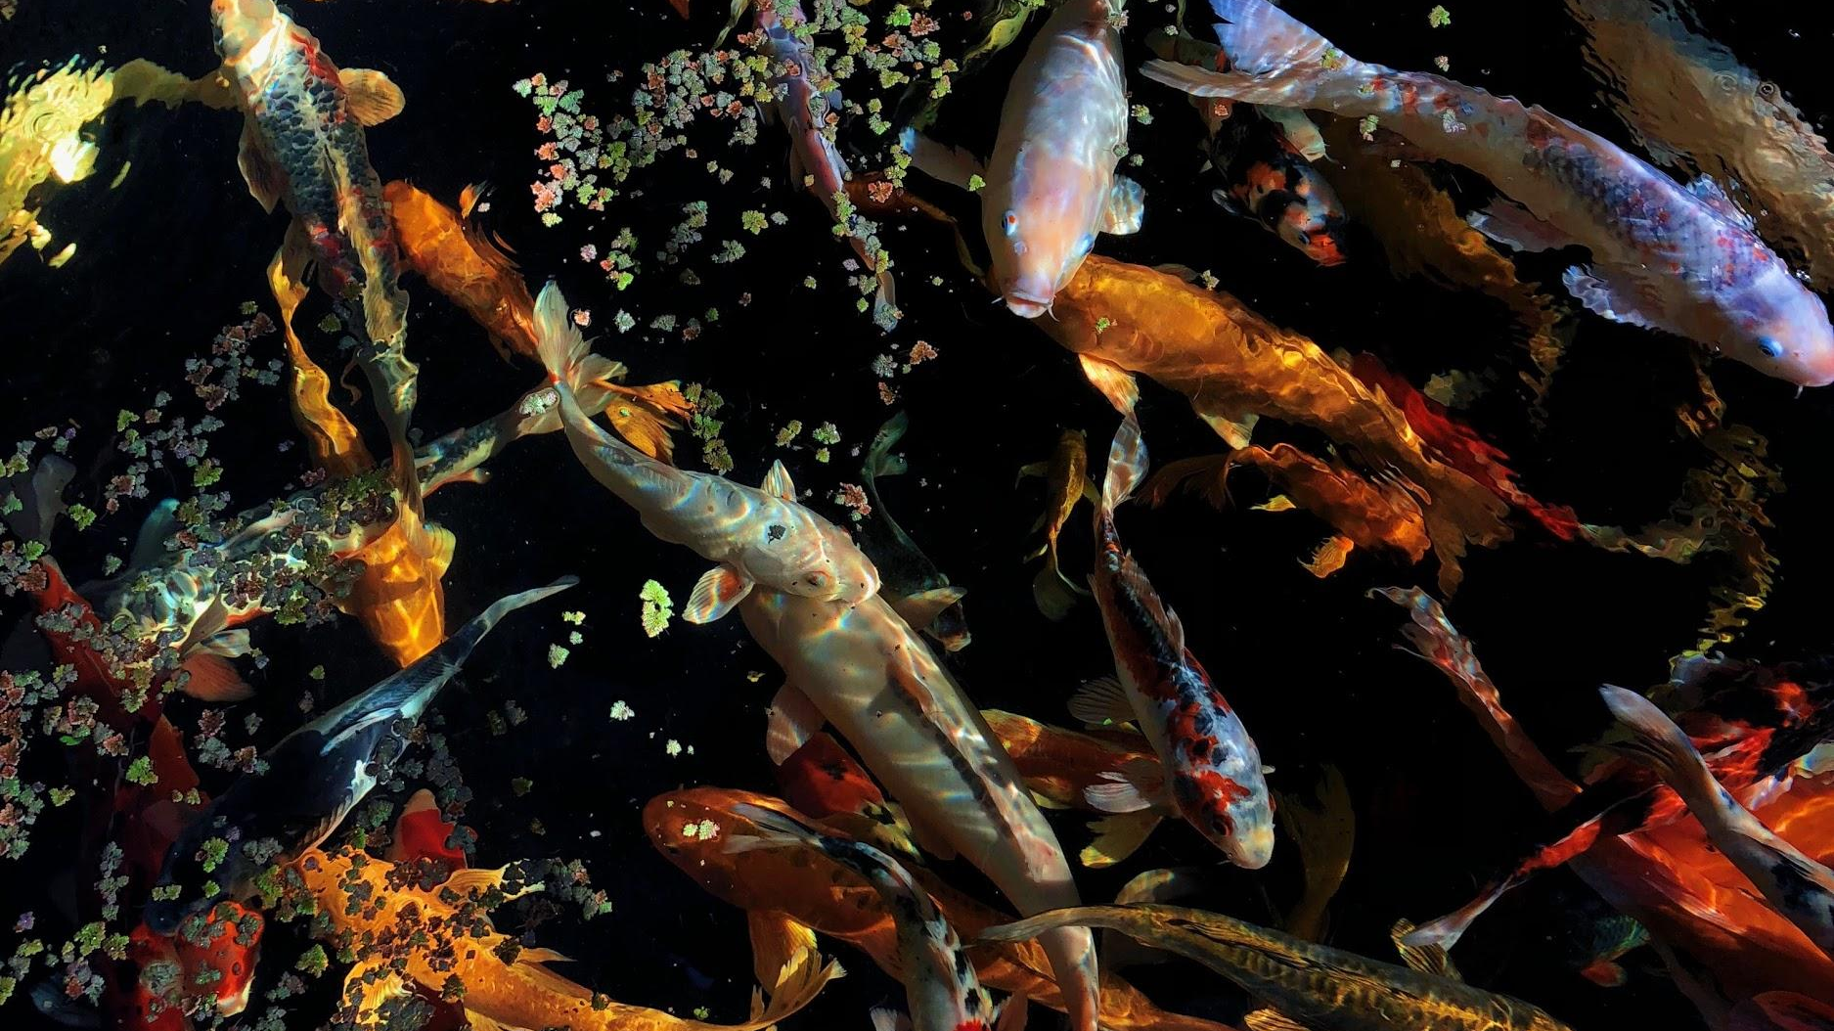
Using the picture:
What are 2 observations?
What is one inference?

Slide 11
We will describe the characteristics of organisms.
TRACK WITH ME
READ WITH ME
We will define organism.
We will list the common characteristics of organisms.
We will compare living, non-living and dead things.
DECLARE THE OBJECTIVE
Read the learning objective to your partner.
Notes:
Learning Objectives contain concepts (nouns, big ideas), skills (verbs, measurable behaviours) and sometimes context (restricting or targeting conditions).
●Example: Students will be able to describe the concept of density and apply it to floating and sinking.
●
Success criteria are specific measurable outcomes that if met mean that the student has met the learning objective.
Examples:
•Students will be able to compare densities of substances using mass and volume.
•Students will be able to identify whether a solid or liquid will float or sink in a liquid based on their densities.

Slide 12
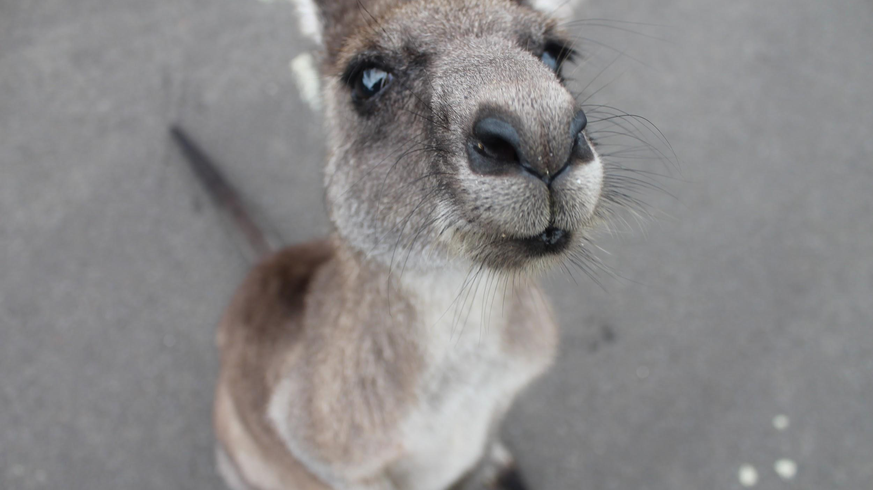
We will describe the characteristics of organisms.
Is a kangaroo living? How do you know?
What characteristics do living things have?

Slide 13

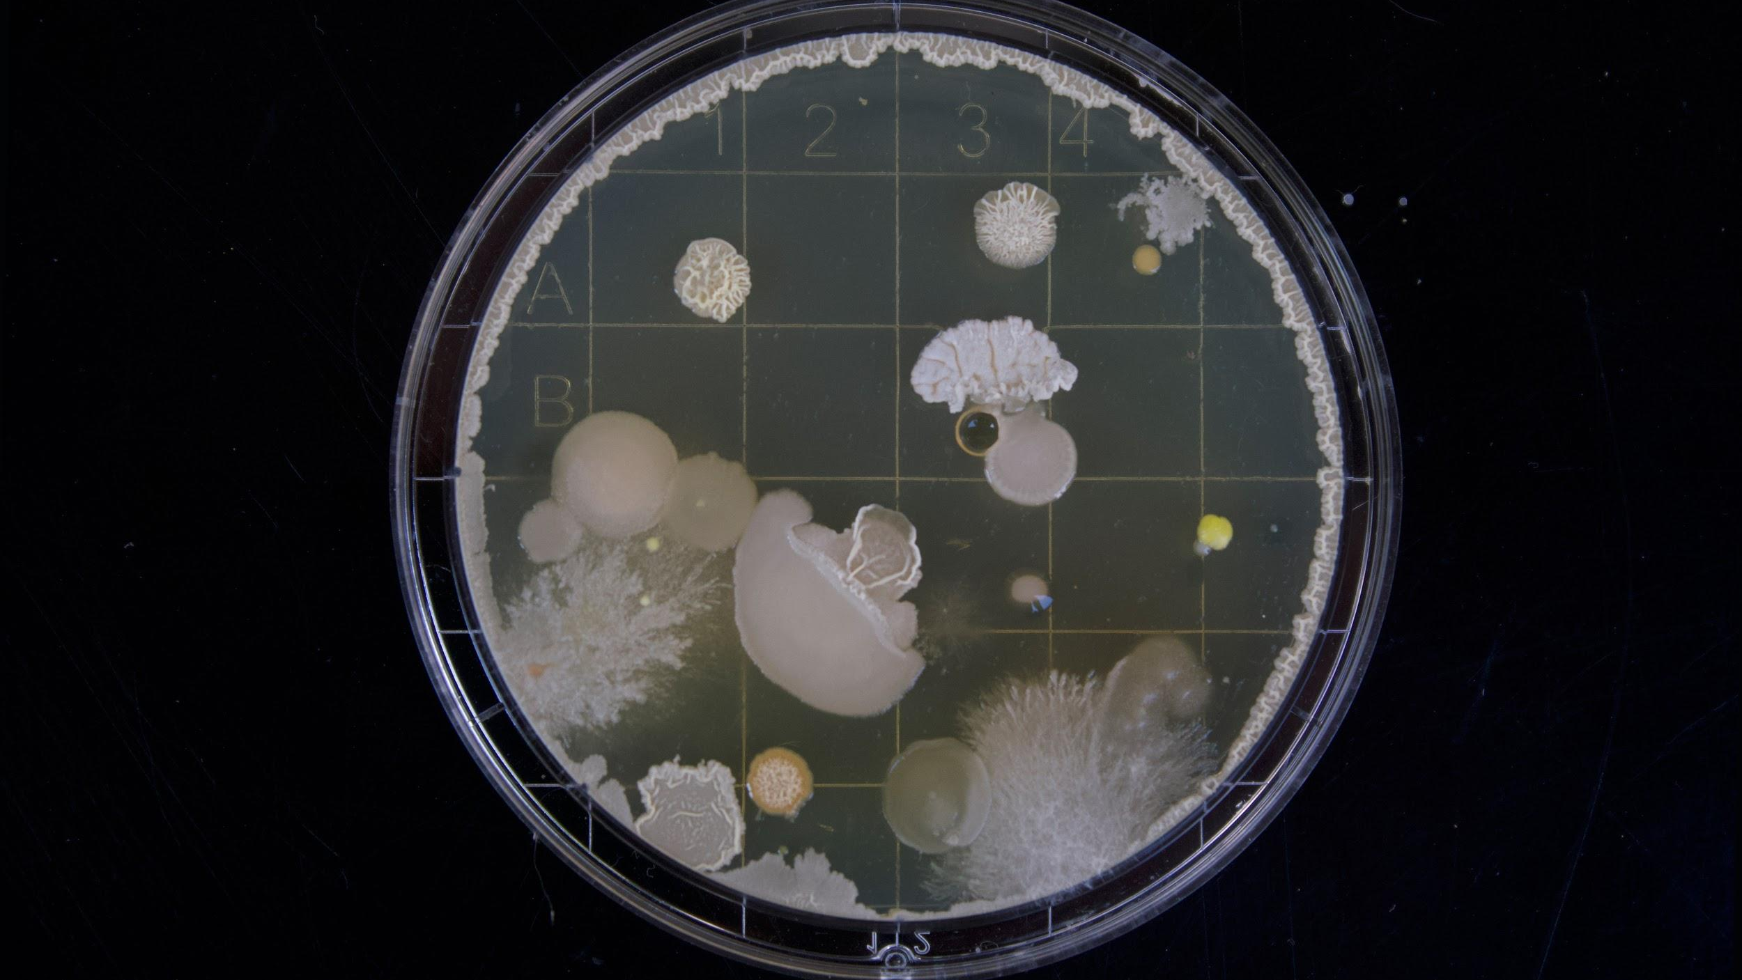
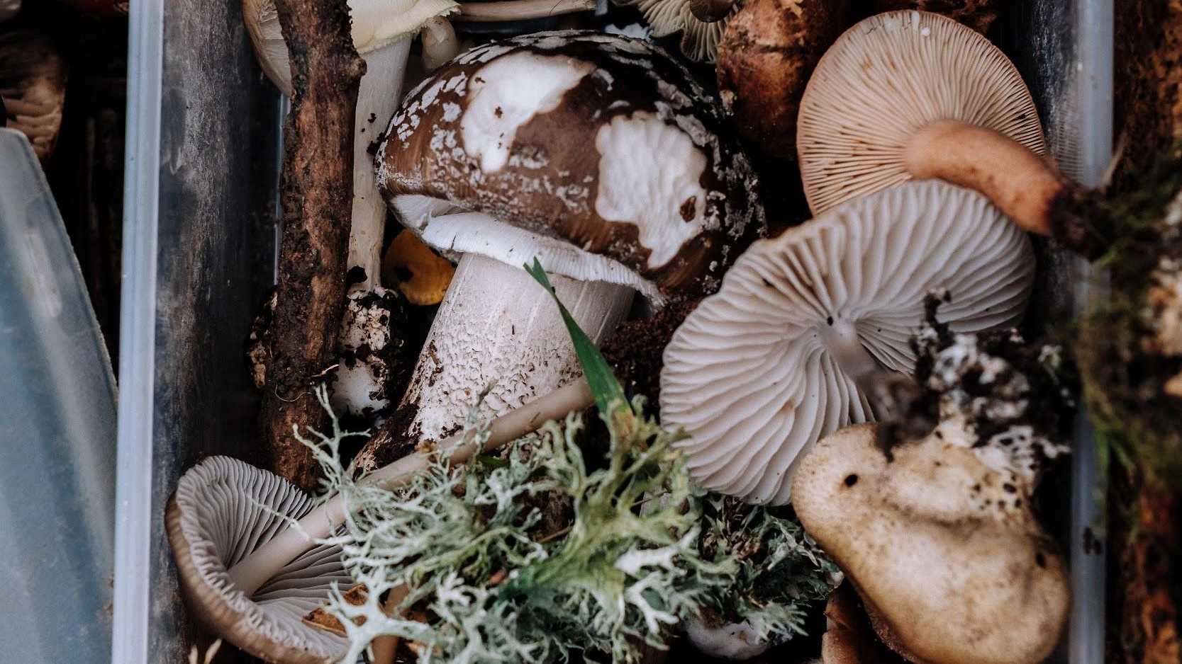
We will describe the characteristics of organisms.
An organism is a living thing.
Organism in a broad word that includes anything that is living or was once alive.
Examples of things that would be called an organism include:
Plants
Animals
Bacteria
Fungi (mushrooms)
CHECK FOR UNDERSTANDING
What is an organism? List three things that you could call an organism.

Slide 14
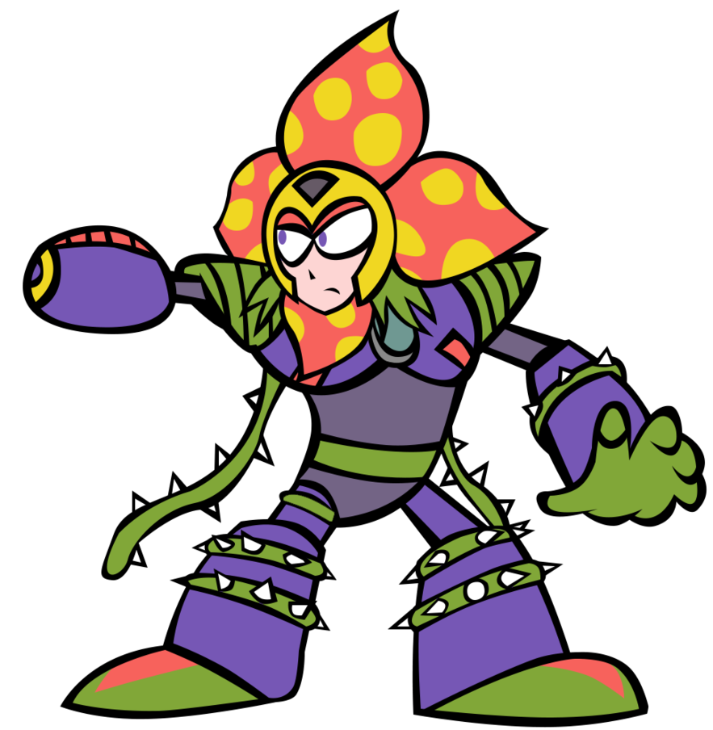
We will describe the characteristics of organisms.
There are eight characteristics₁ that all living things have in common.
We can remember them using the acronym MRS GRENC
Move
Reproduce
Sensitive
Grow
Respire
Excrete₂ wastes
Nutrition
Cells
CHECK FOR UNDERSTANDING
How many characteristics do all living things have in common?
VOCABULARY
1 - features or qualitites. 2 - get rid of/ release

Slide 15
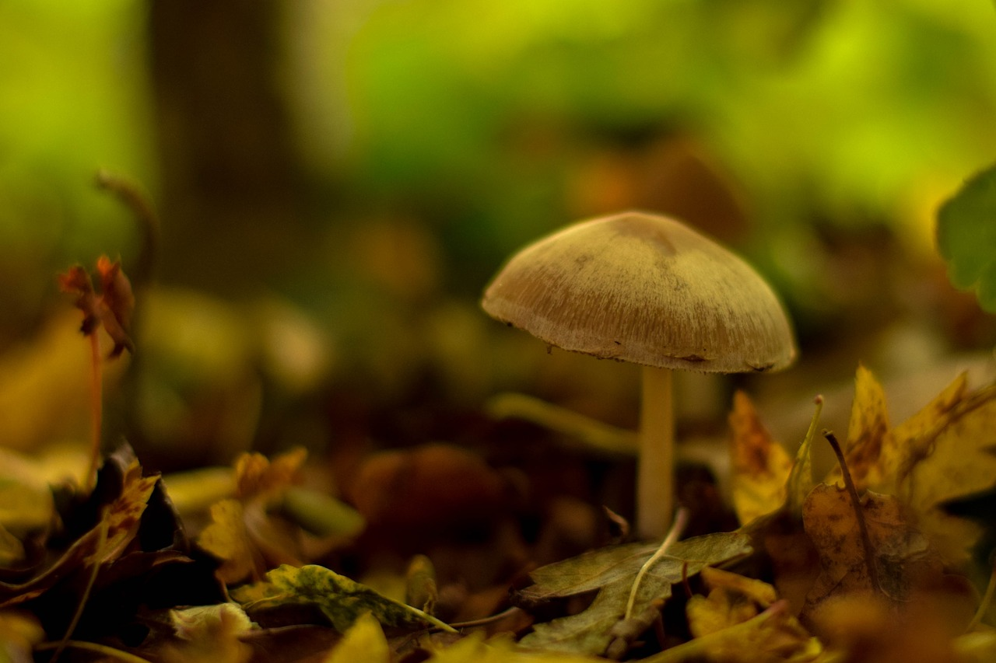
We will describe the characteristics of organisms.
If it has these characteristics, it is a living thing.
If it doesn’t have these characteristics, it is non-living.
If it had these characteristics, it is dead.
Move
Reproduce
Sensitive
Grow
Respire
Excrete₁ wastes
Nutrition
Cells
CHECK FOR UNDERSTANDING
What is the difference between a living and dead thing?
VOCABULARY
1 - get rid of/ release

Slide 16
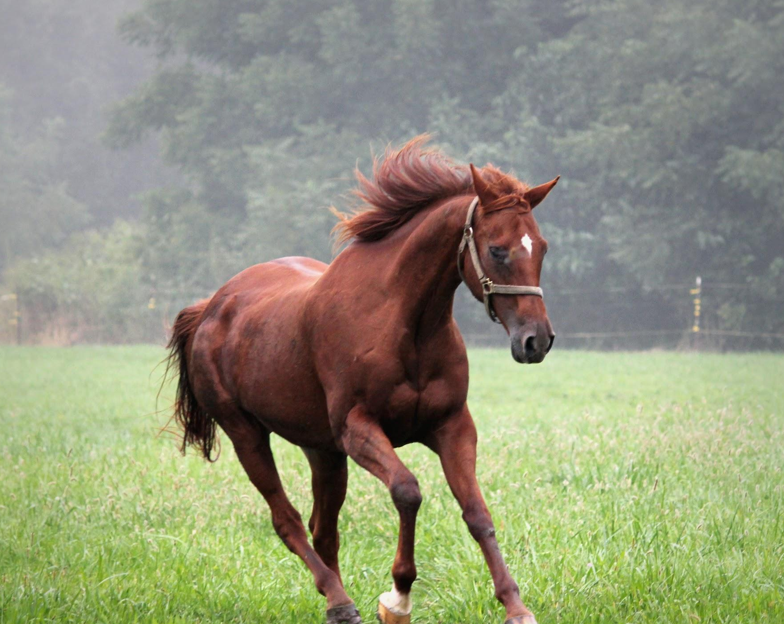
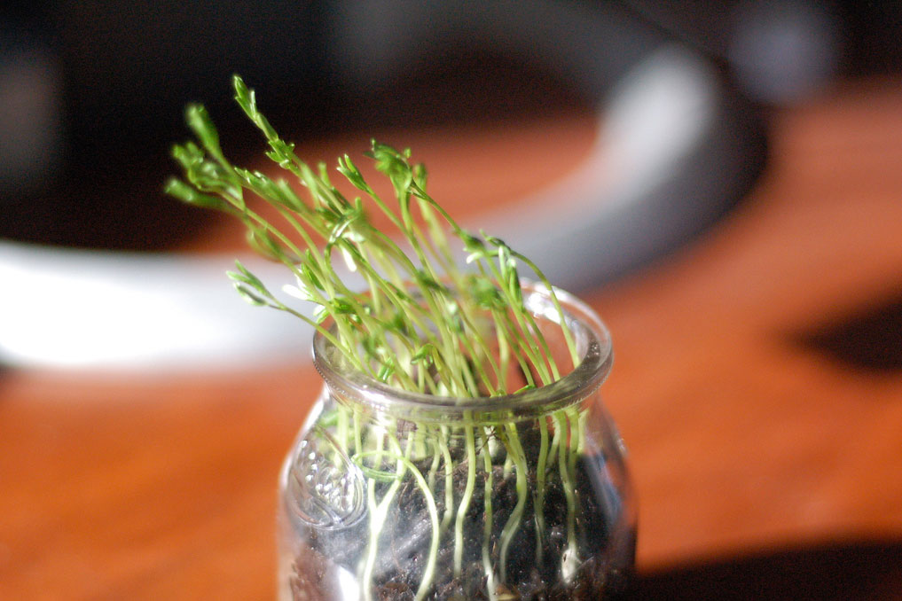
We will describe the characteristics of organisms.
The eight 8 characteristics of all living things:
Move
R
S
G
R
E
N
C
CHECK FOR UNDERSTANDING
Does water in a stream move? Would you consider it a living thing? Explain.
MOVE
All living things move.
Animal movements are usually obvious₁ but other all other living things move too.
For example plants move their leaves towards light.
VOCABULARY
1 - easily noticed.

Slide 17
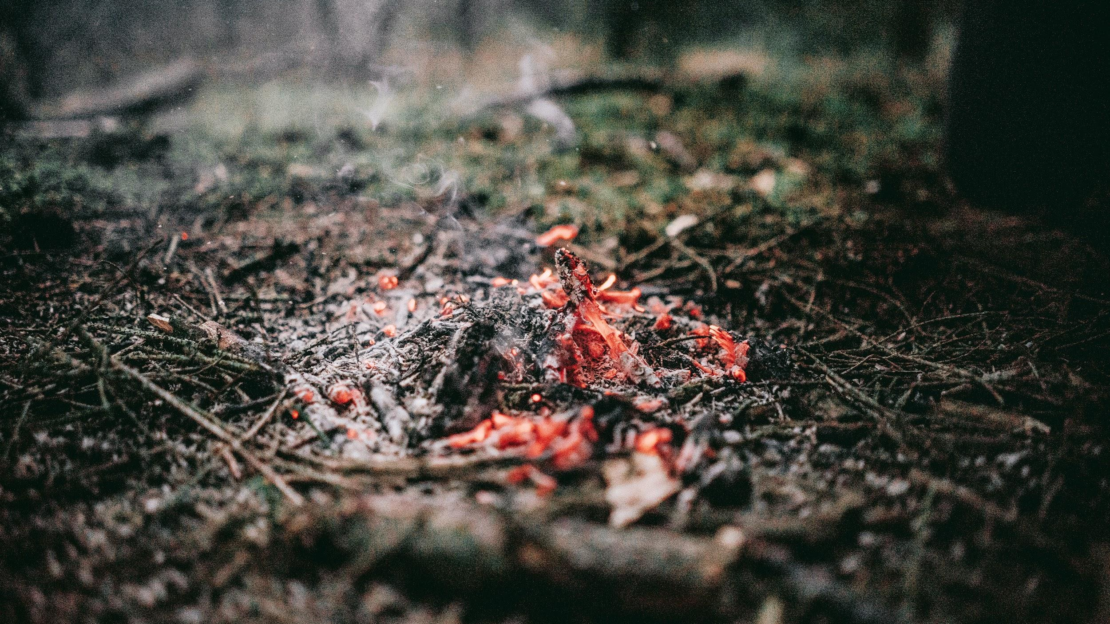
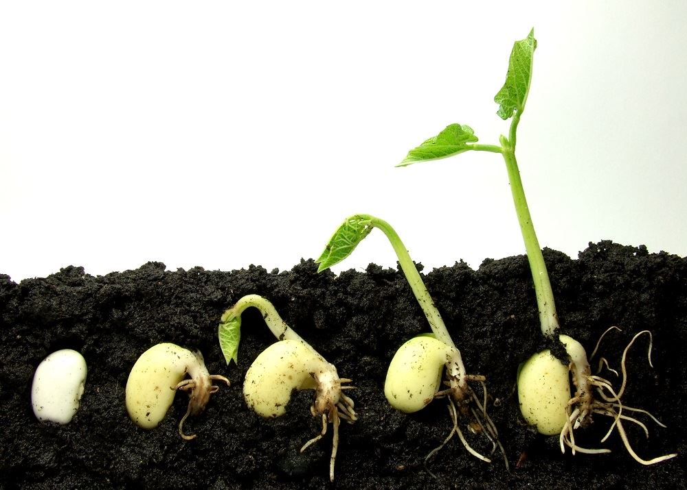
We will describe the characteristics of organisms.
The eight 8 characteristics of all living things:
M
Reproduce
S
G
R
E
N
C
CHECK FOR UNDERSTANDING
Fire can spread by embers to another area during a fire. Is it living? Explain
REPRODUCE
Reproduction is the process by which living things make new life.
All living things reproduce.
Animals usually mate to produce offspring₁.
Plants may produce seeds or divide by asexual₂ reproduction.
Bacteria divide into more bacteria.
VOCABULARY
1 - babies/ young. 2 - only one parent needed.

Slide 18
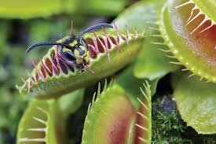
We will describe the characteristics of organisms.
The eight 8 characteristics of all living things:
M
R
Sensitive
G
R
E
N
C
CHECK FOR UNDERSTANDING
What are some things in the environment that might be considered stimuli?
SENSITIVE
All living things respond to stimuli₁ in their surrounding environment (e.g. movement).
Animals might see a predator and run.
An animal may brush past a plant and the plant responds by moving.
VOCABULARY
1 - plural (singular: stimulus), a thing that causes a reaction.

Slide 19
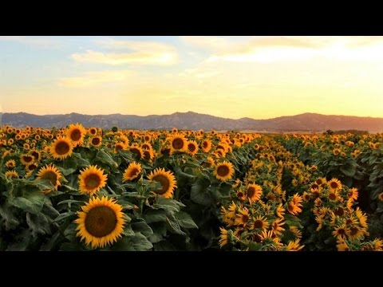

We will describe the characteristics of organisms.
CHECK FOR UNDERSTANDING
Why do sunflowers follow the sun?

Slide 20
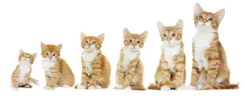
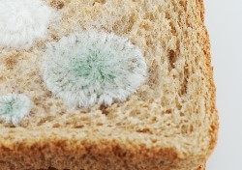
We will describe the characteristics of organisms.
The eight 8 characteristics of all living things:
M
R
S
Grow
R
E
N
C
GROW
All living things grow and get bigger.
Animals grow from young to adults.
Plants grow from seeds to adults.
CHECK FOR UNDERSTANDING
Is mould living? Explain.

Slide 21
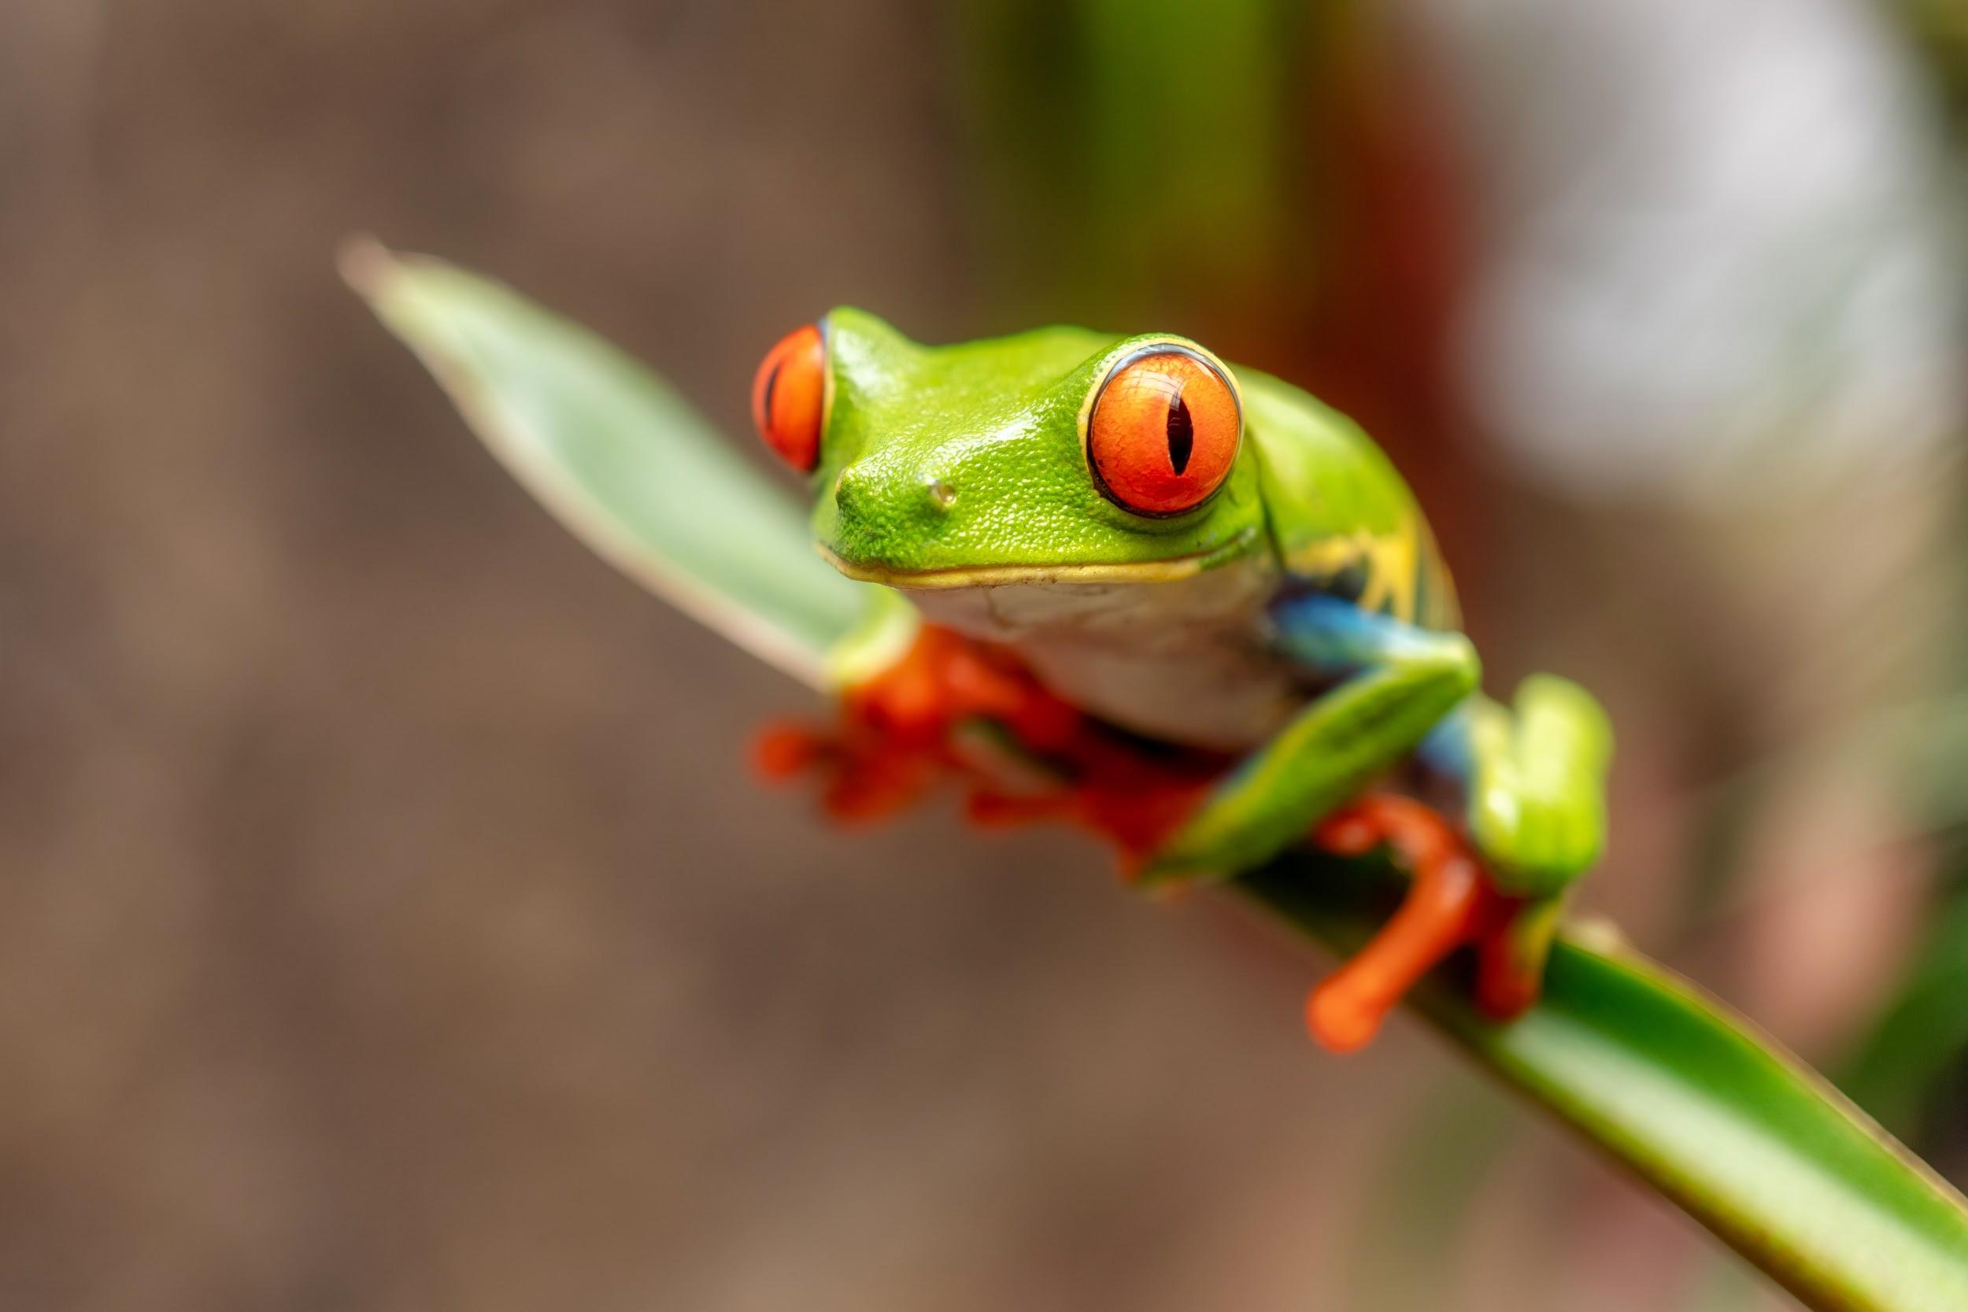
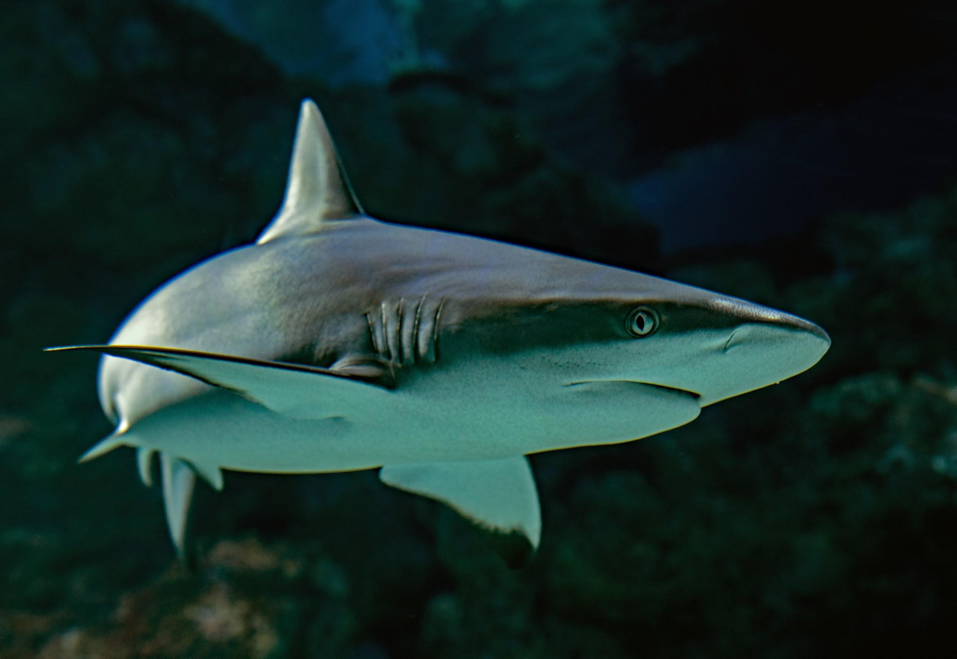
We will describe the characteristics of organisms.
The eight 8 characteristics of all living things:
M
R
S
G
Respire
E
N
C
CHECK FOR UNDERSTANDING
If frogs breathe through their skin, how are gases getting in and out of their body?
RESPIRE
All living things exchange₁ oxygen and other gases.
Animals might have lungs or gills to allow this.
They also need to release energy in cells to survive.
VOCABULARY
1 - give and receive something.

Slide 22
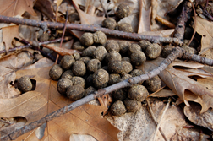
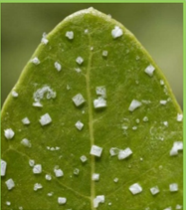
We will describe the characteristics of organisms.
CHECK FOR UNDERSTANDING
What wastes do we produce?
The eight 8 characteristics of all living things:
M
R
S
G
R
Excrete wastes
N
C
EXCRETE WASTES
All living things produce wastes.
Nutrition, water and gases are needed by living things.
Once living things use these resources, they must remove the leftovers.

Slide 23
We will describe the characteristics of organisms.
The eight 8 characteristics of all living things:
M
R
S
G
R
E
Nutrition
C
NUTRITION
All living things need nutrients₁.
Animals eat other living things.
Plants absorb nutrients through their roots.
Fungi feed on decaying₂ living things.
CHECK FOR UNDERSTANDING
Where do we get our nutrients from?
VOCABULARY
1 - food or nourishment. 2 - rotting or dying

Slide 24
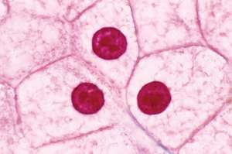
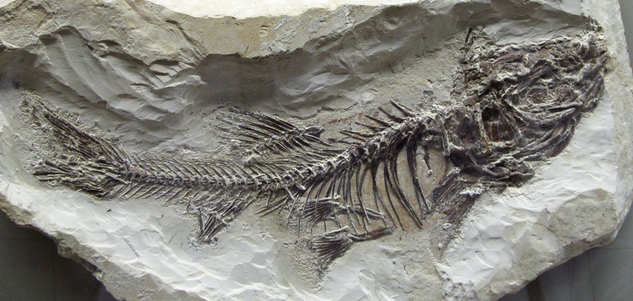
We will describe the characteristics of organisms.
The eight 8 characteristics of all living things:
M
R
S
G
R
E
N
Cells
Every organism is made up of at least 1 cell. A cell is the smallest unit of life.
CHECK FOR UNDERSTANDING
Would this fossil be living, non-living, or dead?

Slide 25
We will describe the characteristics of organisms.
Complete the table below
Thing | Move | Reproduce | Sensitive | Grow | Living, Non-living or Dead?
Sunflower plant
Rock
Caterpillar
Brown leaves on ground
Fire
Cheese
HINT
If it has the characteristics of MRS GRENC, it is a living thing. If it doesn’t have these characteristics, it is non-living. If it had these characteristics, it is dead.

Slide 26
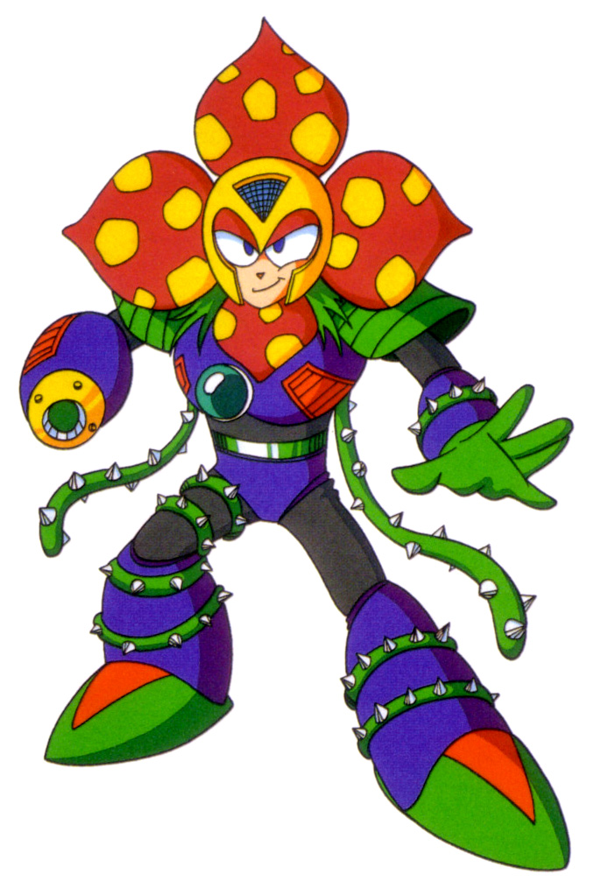
We will describe the characteristics of organisms.
It’s important for us to identify living, non-living and dead things so we can see how they interact with one another.
We now know common characteristics shared by living things.
This is important to know before we start looking at their differences and classifying them further this term.
CHECK FOR UNDERSTANDING
What is one difference between a living and non-living thing?

Slide 27
We will describe the characteristics of organisms.
The eight 8 characteristics of all living things are:
M
R
S
G
R
E
N
C

Slide 28
We will describe the characteristics of organisms.
You are now going to examine an area in the school grounds in order to identify the living, non-living and dead things within that area.
Item found | Living, non-living or dead? | Justification (why?)
What features did your item have that made you categorise it as living, non-living or dead?
Were any items hard to categorise?
Notes:
Please include tasks/questions here rather than just referring to a worksheet. This will save on photocopying and facilitate sharing with other schools.
Try and build tasks/questions which escalate through Bloom’s Taxonomy. This will help with differentiation.

Slide 29
We will describe the characteristics of organisms.
We will define organism.
We will list the common characteristics of organisms.
We will compare living, non-living and dead things.
CHECK FOR UNDERSTANDING
Check Success Criteria.

Slide 30
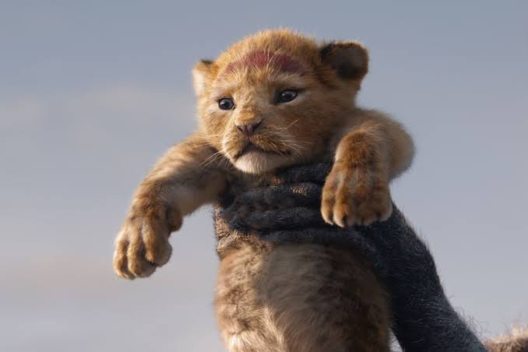
We will describe the characteristics of organisms.
The eight 8 characteristics of LIONS are:
Move- lions can run at 80 km/hour
Reproduce - females give birth to live young
Sensitive - respond to their surroundings, e.g. hunt prey, seek shade in the heat
Grow - get bigger from cub to adult
Respire - release energy from food into cells
Excrete wastes - produce faeces, urine, sweat, and breathe out carbon dioxide
Nutrition - eat other animals to get their energy
Cells - are made up of millions of cells

Slide 31


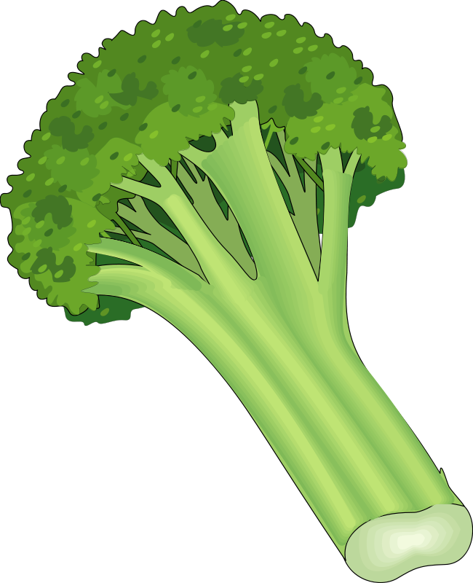

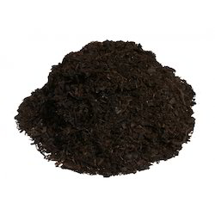
We will describe the characteristics of organisms.
Task
Task
CHECK FOR UNDERSTANDING
N
Complete the Life Processes Worksheet.
Create a poster for your life process.
HINT
Students, remember….
VOCABULARY
Notes:
Please include tasks/questions here rather than just referring to a worksheet. This will save on photocopying and facilitate sharing with other schools.
Try and build tasks/questions which escalate through Bloom’s Taxonomy. This will help with differentiation.

